Slide 1
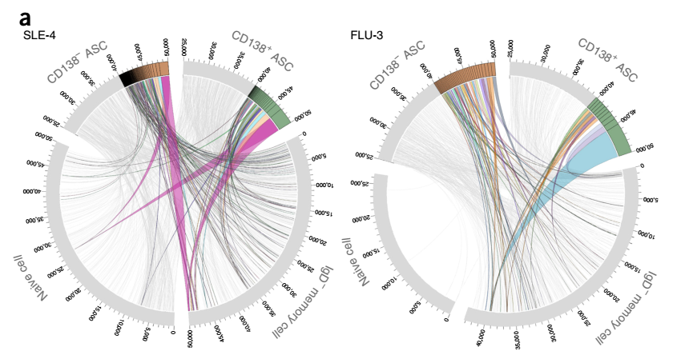
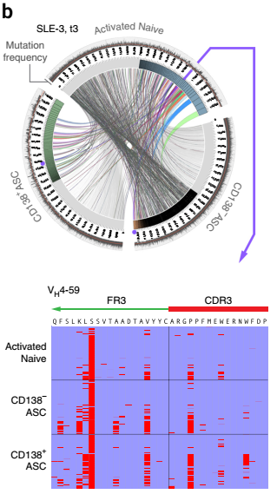
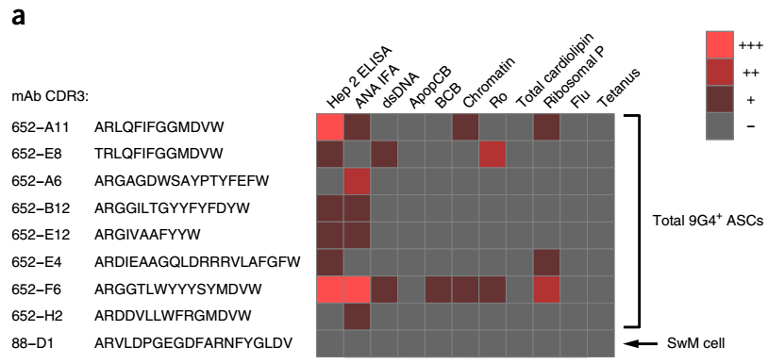
Background
Activated Naïve B cells were important source of ASCs and serum autoantibodies during SLE flares.
4
6
8
Nat Immunol. 2015 Jul;16(7):755-65.

Slide 2
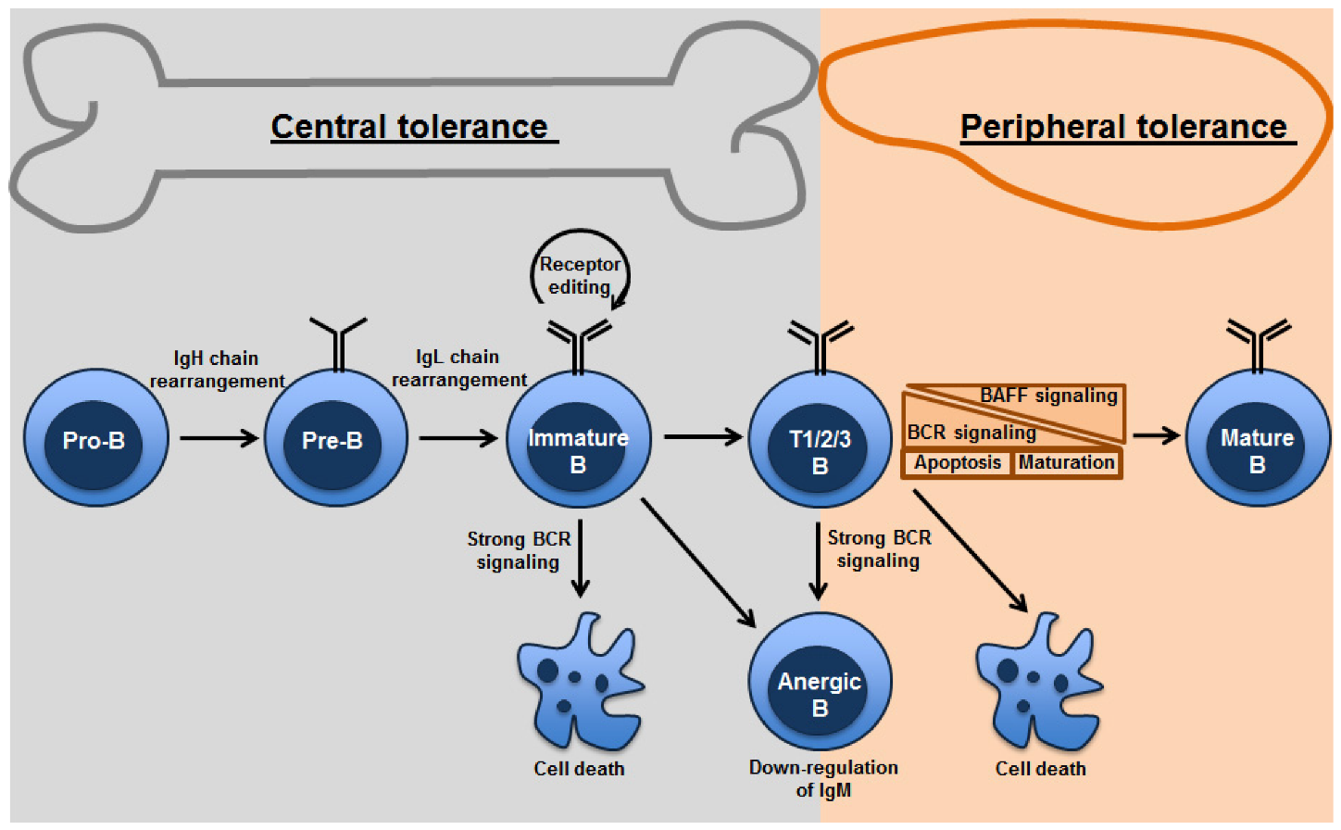
Hypothesis
ASCs may have clonal linkage with other B cell subsets in SLE patients
From BND cells (Anergic B cell) ？？
Antibodies 2014, 3(1), 116-129;

Slide 3
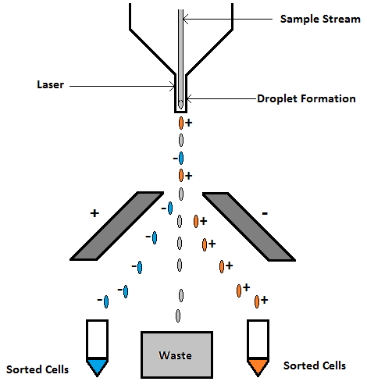
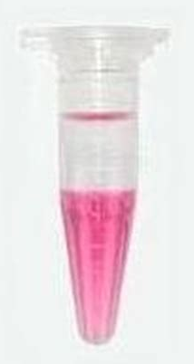
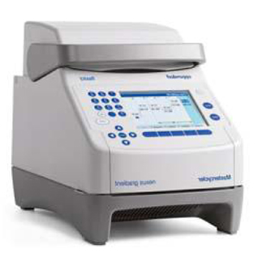
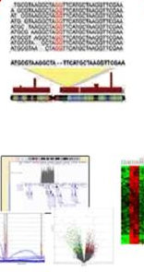
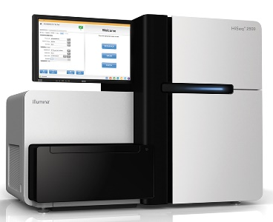
Sort B cell subsets from
and Healthy people
RNA isolation
Clone VH gene by
3 rounds PCR
ASC/Memory/B_{ND} /Conventional Naïve/ AcN
Sorted B cell subsets:
ASC: Antibody secreting cell
Memory B cell
BND: Anergic B cell
Conventional Naïve B cell
AcN: Activated Naïve B cell
Data analysis
Next generation sequencing

Slide 4
Cell number of sorted B cell subsets
 | ASC | Memory | Conventional Naïve | B_{ND} | AcN
HC1 | 1917 | 31690 | 20938 | 13220 | 814
HC2 | 150 | 31692 | 10580 | 26949 | 5511
HC4 | 2208 | 2620 | 18307 | 2918 | 339
S22 | 1251 | 8501 | 11000 | 372 | 13014
S25 | 468 | 1088 | 1482 | 384 | 5464
S229 | 776 | 4264 | 16752 | 7217 | 316

Slide 5
Cell number of sorted B cell subsets
 | ASC | Memory | Conventional Naïve | B_{ND}
HC257 | 7057 | 237374 | 432632 | 87411
HC258 | 3915 | 131124 | 267271 | 31590
HC259 | 5101 | 153584 | 185206 | 27803
HC260 | 5435 | 159548 | 211668 | 17131
S253 | 116 | 15118 | 46832 | 17065
S262 | 643 | 100000 | 80748 | 21323
S274 | 459 | 27271 | 37038 | 12305
S307 | 307 | 29463 | 25346 | 15334

Slide 6
Objective
Compare the self-reactivity (VDJ segment, CDR3 length, or other CDR3 information)
2. Find the Shared clones (or clonal linkage) among different B cell subsets of each subject, especially B_{ND} cells with other subsets.

Slide 7
Part of results

Slide 8
Part of results

Slide 9
Part of results

Slide 10
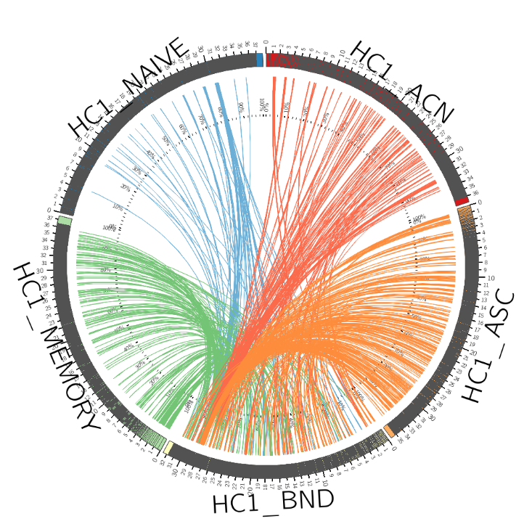
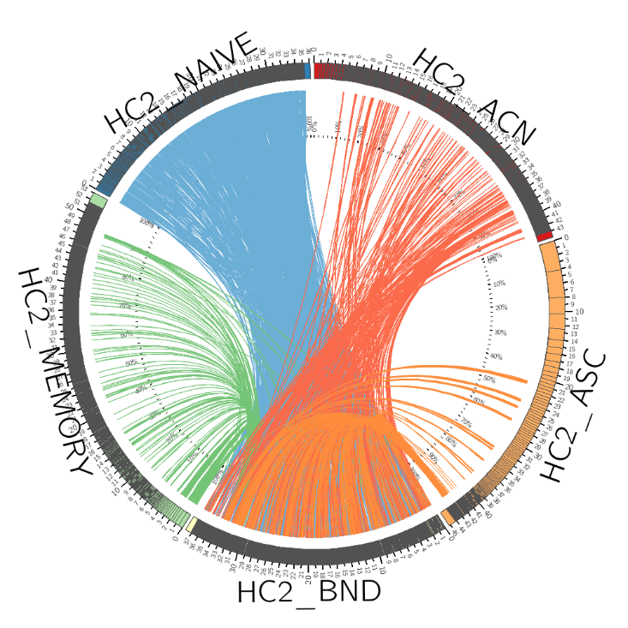
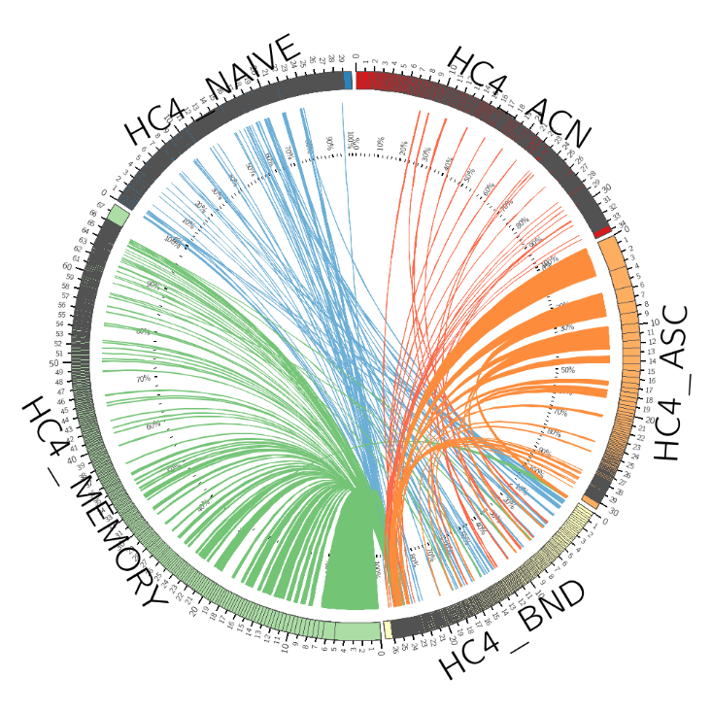
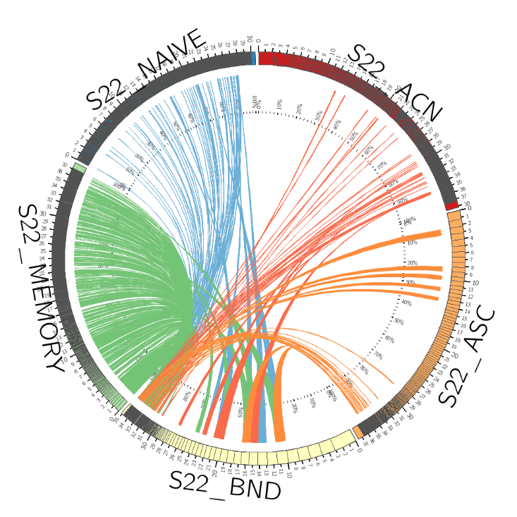
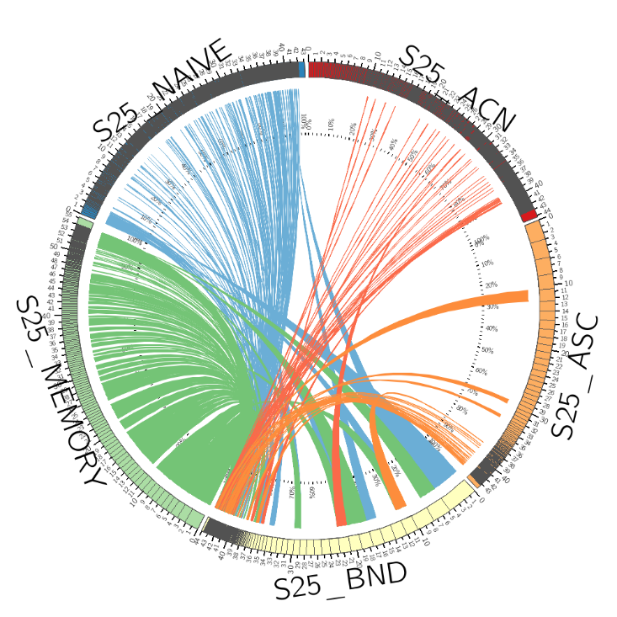
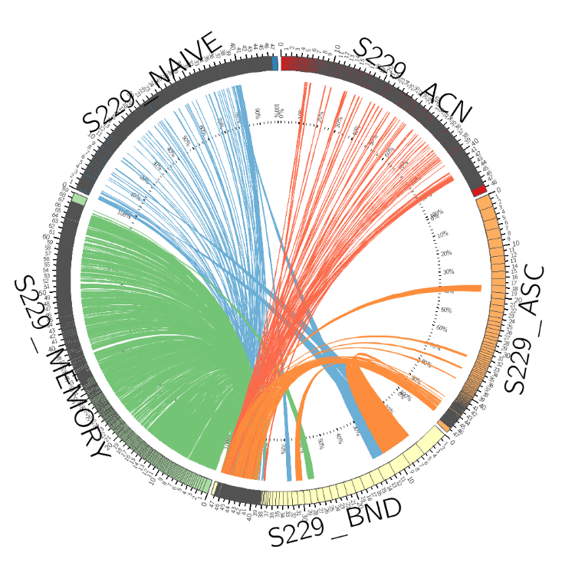
Linkage_BND_Others
Part of results
# Numbers near Subject_Subset
are sorted cell numbers
HC1
HC2
HC4
20938
814
10580
5511
18307
339
2208
31692
1917
17459
150
2620
2918
13220
26949
S22
S25
S229
11000
13014
1482
5464
16752
316
8501
1251
1088
468
4264
776
372
384
7217

Slide 11
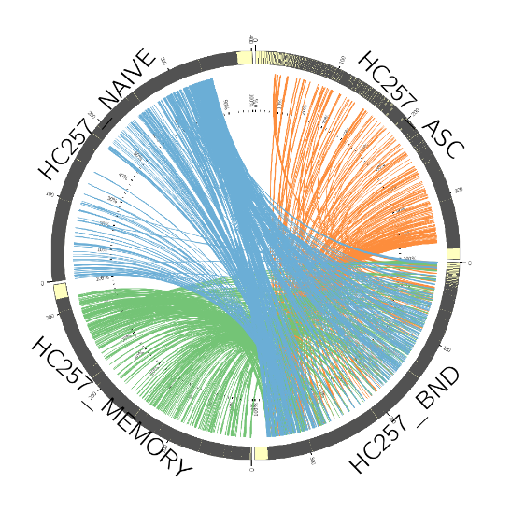
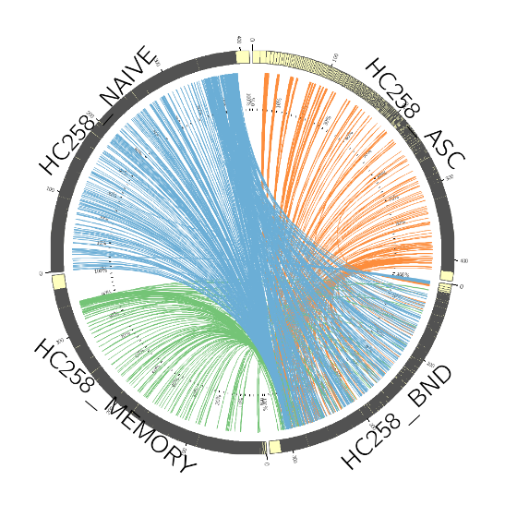
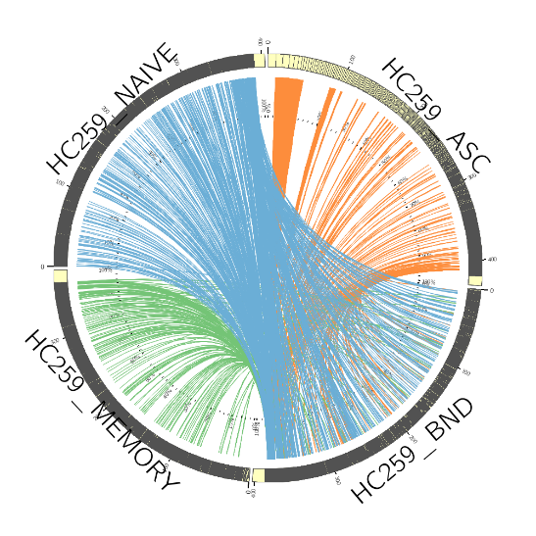
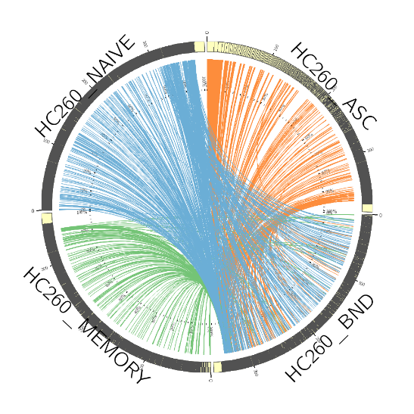
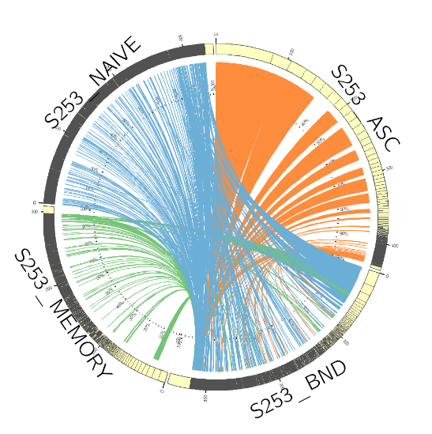
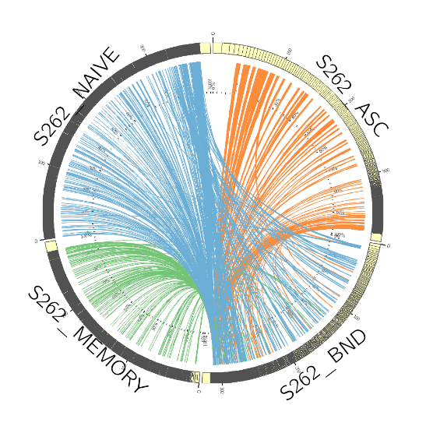
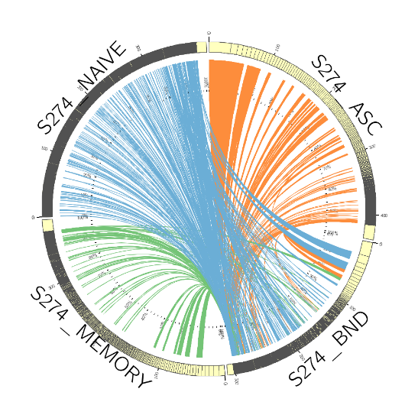
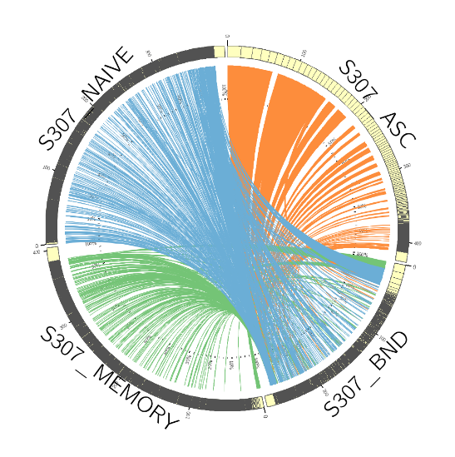
Part of results
Linkage_BND_Others
432632
7057
267271
3915
185206
5101
211668
5435
237374
87411
131124
31590
153584
27803
159548
17131
HC257
HC258
HC259
HC260
46832
116
80748
643
37038
459
25346
307
15118
17065
100000
21323
27271
12305
29463
15334
S253
S262
S274
S307

Slide 12
Question
Data quality ?
Is the clonal linkage analysis correct ?
Further analysis ?

